Slide 1
DEVICE FOR ENDANGERED SPECIES
(A Smart Collar Prototype for Wildlife Monitoring)
By, Preethika M
( B.E. Electronics and Communication Engineering )

Slide 2
Abstract
Problem Statement:
Many endangered species face extinction due to poaching, habitat destruction, and lack of real-time monitoring.
Manual monitoring is labor-intensive, costly, and provides limited coverage.
Need for a Tech-Based Collar
A smart collar integrates sensors, GSM, and GPS to continuously track animal health and location.
Provides real-time alerts to authorities, helping in faster intervention.
Enables conservationists to study migratory patterns, habitat usage, and health status with accurate data.

Slide 3
Objectives
Monitor heartbeat (pulse sensor) and motion (PIR sensor) in real-time.
Trigger alerts when abnormal conditions are detected.
Send SMS alerts via GSM containing GPS location of the animal.
Assist in preventing poaching, illegal trade, and habitat threats.
Provide continuous data for research on animal behavior and conservation.

Slide 4
Literature Survey
Existing Methods
Manual monitoring → time-consuming, limited coverage.
Radio/GPS collars → track location but costly & need expertise.
ZigBee systems → health monitoring but complex hardware.
Disadvantages
Labor & time intensive.
High cost of devices.
Limited real-time alerts.

Slide 5
Proposed System
System Overview
A wearable smart collar built using Arduino UNO as the control unit.
Continuously monitors health (heartbeat sensor) and activity (PIR sensor).
On detecting abnormalities, it communicates through GSM and attaches GPS coordinates in the alert message.
Compact design ensures comfort and long-term usage
Key Components Integrated
Pulse Sensor → measures heartbeat.
PIR Sensor → detects motion of the animal or surrounding activity.
GSM Module → sends SMS alerts to authorities.
GPS Module → provides real-time location tracking.
Arduino UNO → processes sensor data and controls communication

Slide 6
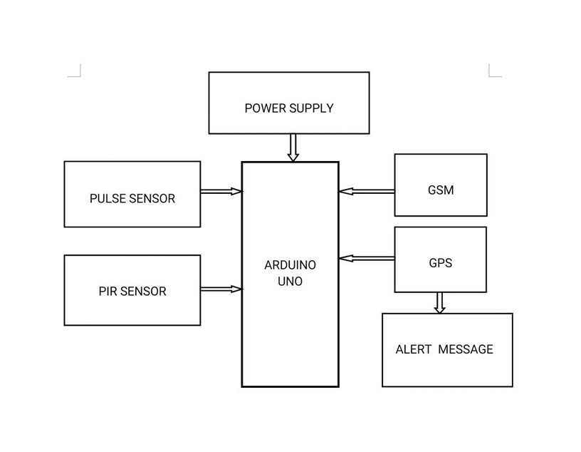
Block Diagram

Slide 7
Hardware & Software Components
Hardware
Arduino UNO – main controller
Pulse Sensor – monitors heartbeat
PIR Sensor – detects animal motion
GSM Module (SIM800L) – sends SMS alerts
GPS Module – provides real-time location
LED + Resistor – alert indicator
Silicon Belt – wearable collar base
Breadboard & Wires – circuit connections
Software
Arduino IDE – coding & debugging
Blynk IoT – remote monitoring & mobile dashboard

Slide 8
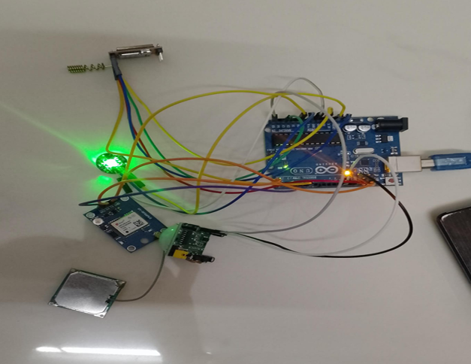
Hardware Setup
GSM
PULSE SENSOR
ARDUINO
PIR SENSOR
GSM MODULE

Slide 9
Working Principle
Sensors (Pulse + PIR) continuously monitor animal health and movement.
When abnormal pulse or suspicious motion is detected:
Arduino processes the signals.
GSM module sends an SMS alert to authorities.
GPS module attaches the exact location.
LED blinks as a local alert indicator
Authorities receive real-time info → enabling quick action against threats like poaching or habitat risk.

Slide 10
Code Snippet
int pirValue = digitalRead(PIR_PIN);
int heartRate = pulseSensor.getBeatsPerMinute();
float objTemp = mlx.readObjectTempC();
if (pirValue == HIGH || heartRate > 100 || objTemp > 38.0) {
Serial.println("⚠ ALERT: Abnormal condition detected!");
gsmSerial.println("AT+CMGS=\"+91XXXXXXXXXX\"");
gsmSerial.println("Animal in danger! Sending GPS...");

Slide 11
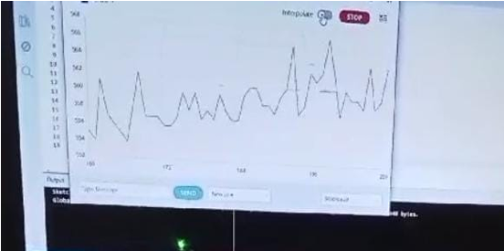
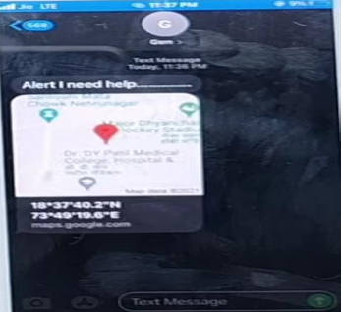
Outputs
Arduino IDE Output

Slide 12
Applications
AI Integration – Use machine learning to analyze sensor data and detect patterns more accurately.
Additional Sensors – Add temperature, humidity, and sound sensors for a holistic understanding of animal health and environment.
Data Fusion – Combine multi-sensor data for deeper insights into species’ well-being and behavior.
Energy Efficiency – Explore low-power designs for longer operational life in the field.

Slide 13
Future Enhancements
AI Integration – Use machine learning to analyze sensor data and detect patterns more accurately.
Additional Sensors – Add temperature, humidity, and sound sensors for a holistic understanding of animal health and environment.
Data Fusion – Combine multi-sensor data for deeper insights into species’ well-being and behavior.
Energy Efficiency – Explore low-power designs for longer operational life in the field.

Slide 14
Conclusions
.
The device represents a major step forward in wildlife conservation, combining sensors, communication, and tracking for real-time protection.
Acts as a vigilant sentinel against poaching and habitat threats.
Has potential to grow further with AI, sensor fusion, and energy-efficient upgrades
Stands as a beacon of hope, offering a practical pathway for safeguarding endangered species and preserving biodiversity.

